Slide 1

Is this Weird?
Anomaly Detection in Time Series
Notes:
There’s always next time

Slide 2

Who is this guy?
Fred Frost
Improving the quality of life for the Microsoft Data Professional.
SentryOne: solutions that center around our Monitor • Diagnose • Optimize (MDO) methodology. (Plan Explorer, SQL Sentry, etc)
Development and integration of machine learning tools into the S1 platform to provide predictive and prescriptive analytics to our customers
Data Scientist at SentryOne
ffrost@sentryone.com
/fredfrostdata1
@ffrost162
Notes:
sexy

Slide 3
What’s he going to talk about?
What’s with the questions?
Why are we talking about time series anomaly detection?
What are THE questions?
Q1: What kind of data do I have?
Q2: How well do I understand the processes that generate my outputs?
Q3: What types of anomalies does the consumer of the anomaly detector care about?
Q4: What are my technical constraints?
Summary

Slide 4
Why Time Series Anomaly Detection?
From a business perspective, it’s opportunity:
IHS Markit estimates 27 Billion connected IoT devices
Pervasive across industries and markets
System Sensors for management, performance and optimization
Security and intrusion detection
Fraud Detection
Medical Diagnosis
Automotive & Transportation
Communications
Each and every one of them will need to recognize and handle anomalies

Slide 5

Why Time Series Anomaly Detection?
From a math and CS perspective, it’s both broad and deep
Problem diversity
Solution diversity
Constantly evolving challenges
But…
A set of guiding principles exists to connect problems and solutions

Slide 6
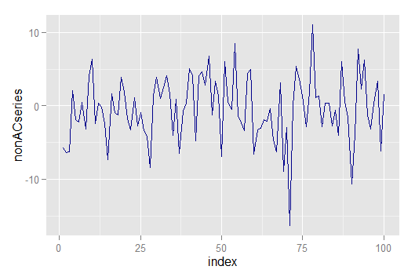
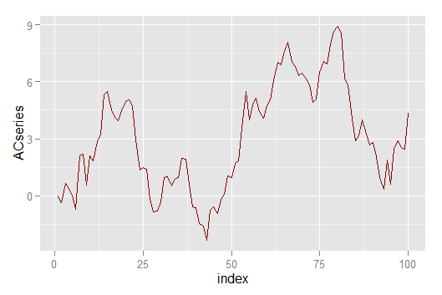
Q1: What kind of data do I have?
Is the data independent and identically distributed (IID)?
Or is it autocorrelated?

Slide 7
Q1: What kind of data do I have?
What is the dimensionality of the data?
Univariate
What is the air pressure in my left front tire?
Multidimensional
What is the air pressure in all of my tires, the ambient air temp, and my current speed?
Massively Multidimensional*
What is all the data we have on all of the individual cars on the road?
*The Curse of Dimensionality

Slide 8


What kind of data do I have?
Vertical Analysis
Horizontal Analysis

Slide 9
Q1: What kind of data do I have?
All the labels
Normal class is labeled
No labels
Temp | Pressure | Label
100 | 38 | Normal
90 | 37 | Normal
95 | 39 | Normal
100 | 22 | Anomaly
Temp | Pressure | Label
100 | 38 | Normal
90 | 37 | Normal
95 | 39 | Normal
Temp | Pressure | Label
100 | 38
90 | 37
95 | 39
100 | 22
Supervised
Semi-Supervised
Unsupervised
But where do these labels come from?
Notes:
Role of expertise in providing labels and reducing dimensionality by making the correct simplifying assumptions

Slide 10
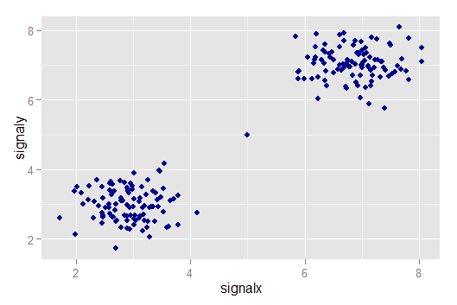
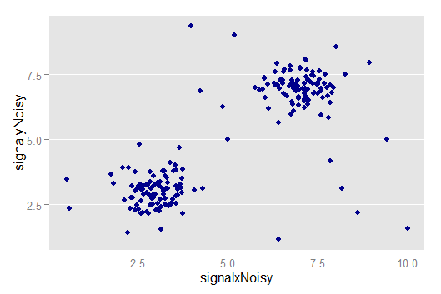
Q1: What kind of data do I have?
How noisy is my system?
Not very
Noise large relative to separation
Notes:
Quiet state vs active state

Slide 11
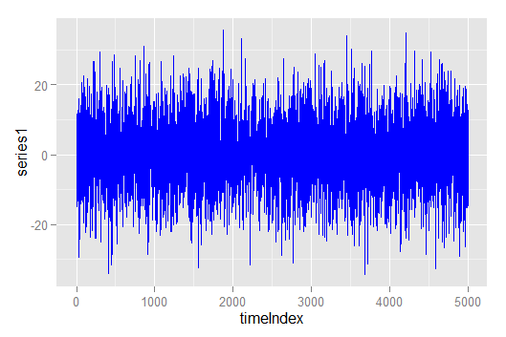
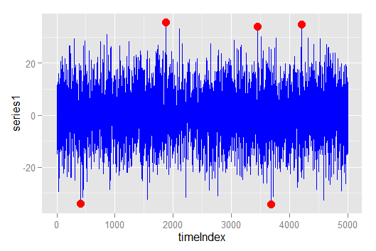
Q2: How well do I understand the system?
What does an outlier in my system look like?
Is it simply an extreme value?

Slide 12
Q2: How well do I understand the system?
Consider a set of univariate, unordered values
X = {1,2,3,13,50,87,88,89}
Which points have the most “outlierness”?
Then consider an ordered time series for an additive process
Y = {1,2,3,13,50,87,88,89}
Now which points have the most “outlierness”?

Slide 13
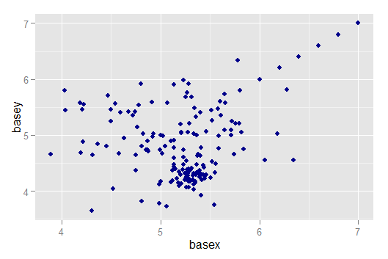
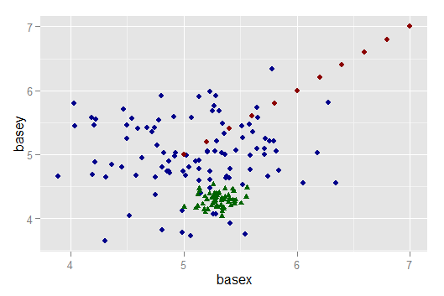
Q2: How well do I understand the system?
Which points are outliers?
Does this help?
Anomaly detection is about the process by which the actual data points are generated

Slide 14
Q2: How well do I understand the system?
Statistical Methods
Do I understand the distributions of values within the series?
Is it possible to detect useful anomalies with the right statistical approach?
Instance Based Methods
Do I understand how many system states there are?
Can I choose an appropriate measure of distance or similarity between points?
Model Based Methods (Single Class + Generative)
Do I have a model that does a good job in reconstructing or fitting the observed data?
When my model doesn’t fit, is that a signal based anomaly, or a bad model?

Slide 15
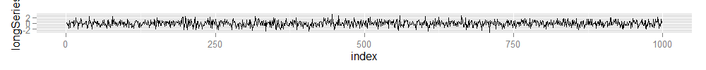
Q3: What kind of anomaly detection provides value?
Streaming analytics- minimal context Quick turnaround while insights are fresh
Offline analytics – Full contextual basis for analysis Identification of long term trends

Slide 16
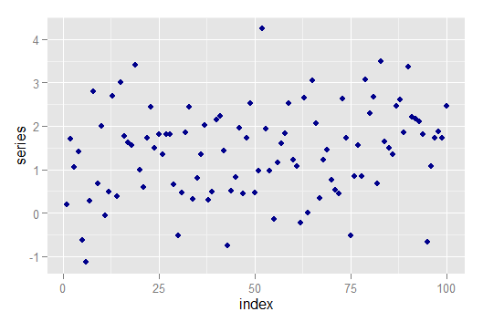
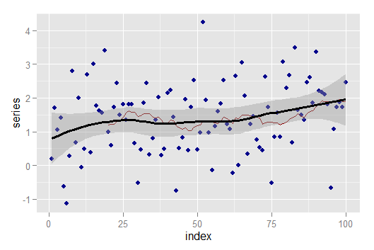
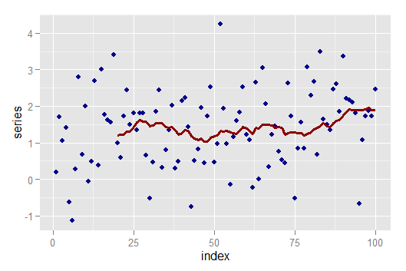
Q3: What kind of anomaly detection provides value?
Can we do some smoothing or do we need to provide results on raw data?
No Smoothing
Loess smoothing
Simple moving average

Slide 17




Q4: What are the technical constraints?
General Architecture Considerations – not unique to anomaly detection
Is the user accessing a web application that is served data from a central location where the analytical heavy lifting occurs? e.g. Alexa/Echo, for now.
Model Training and Inference in the cloud
Is the small bank willing to use public cloud or permit regular model updates?
Model Training and Inference done locally
Can a self-driving car rely on cloud architecture to respond to sudden environmental changes?
Intermittent
Model training in the cloud, with local model inference –
Edge model
Connectivity

Slide 18
Q4: What are the technical constraints?
Are any technology solutions ruled out or preferred because of data concerns?
Limits on local processing:
Too much data to store or process locally, limits streaming windows
Processing requires context granted by other sensors in the system
Limits on cloud processing:
Latency, reliability, security
What is bigger: the analytical process or the data required to sustain it?
Limits on edge architecture:
Not all solutions fit in this model
Requires representation of completed model that data can interact with

Slide 19
Summary
There is no “best” algorithm or technique.
Choosing the “right” solution to an anomaly detection problem depends on the following:
The character of your data
How much clarity you have into how the system transforms inputs into outputs
What types of anomalies you need to detect
The additional technical constraints

Slide 20


